Slide 1
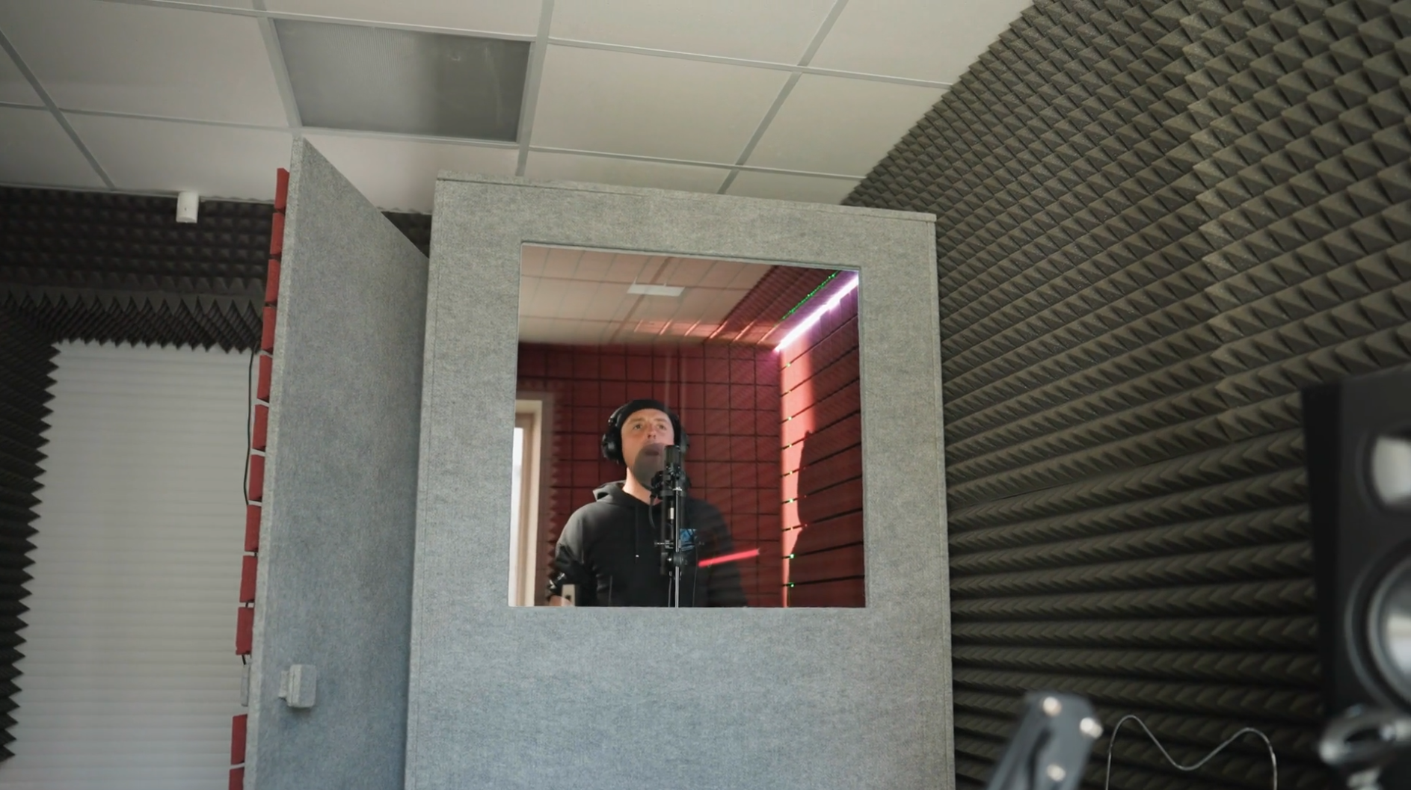
Acoustic Enclosures
Sabine rooms
Tyler Dare

Slide 2
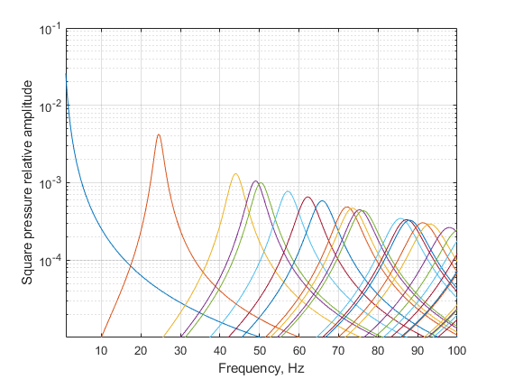
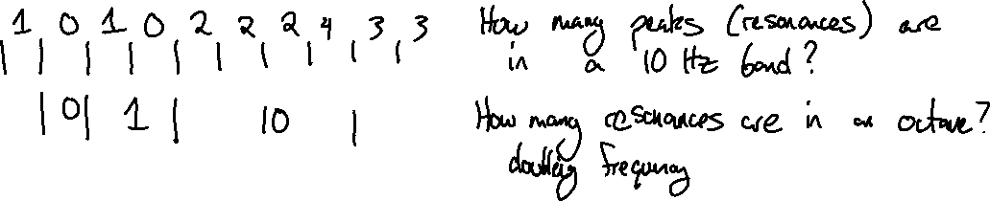
Modal overlap
At high enough frequency, talking about individual modes is less useful. Many modes are participating at a given frequency.

Slide 3
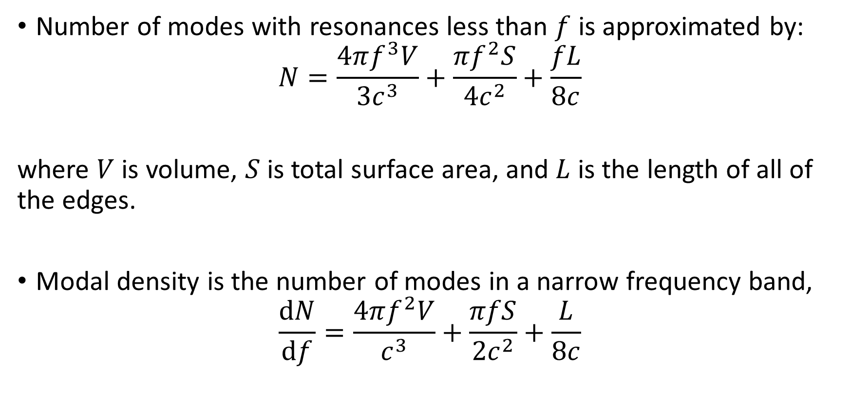
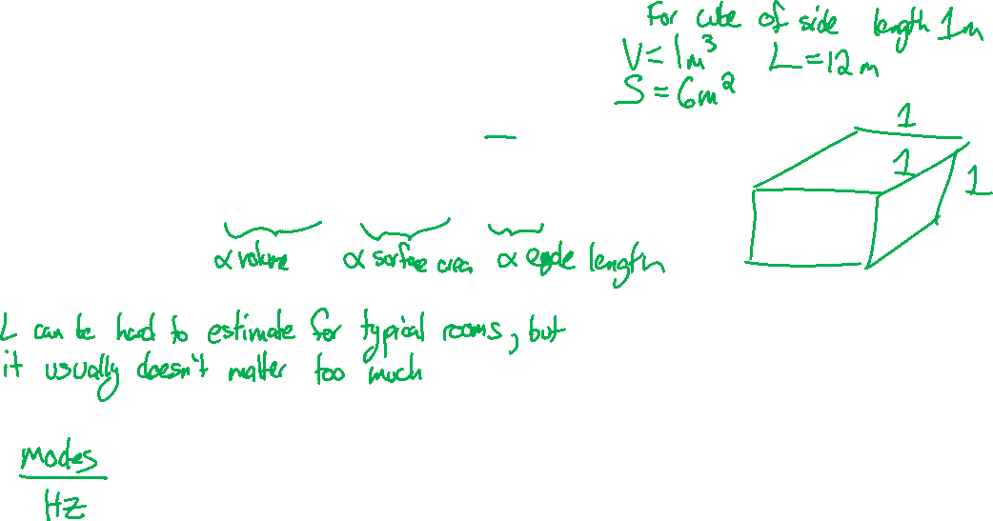
Modal overlap
Number of modes with resonances less than $f$ is approximated by:
$$N=\frac{4πf^{3}V}{3c^{3}}+\frac{πf^{2}S}{4c^{2}}+\frac{fL}{8c}$$
where $V$ is volume, $S$ is total surface area, and $L$ is the length of all of the edges.
Modal density is the number of modes in a narrow frequency band,
$$\frac{dN}{df}=\frac{4πf^{2}V}{c^{3}}+\frac{πfS}{2c^{2}}+\frac{L}{8c}$$

Slide 4

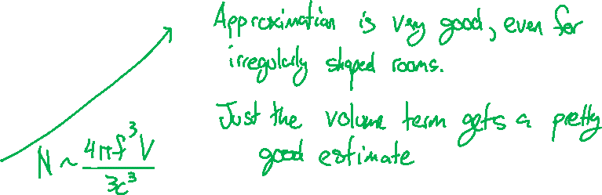
Modal overlap
$$N=\frac{4πf^{3}V}{3c^{3}}+\frac{πf^{2}S}{4c^{2}}+\frac{fL}{8c}$$

Slide 5
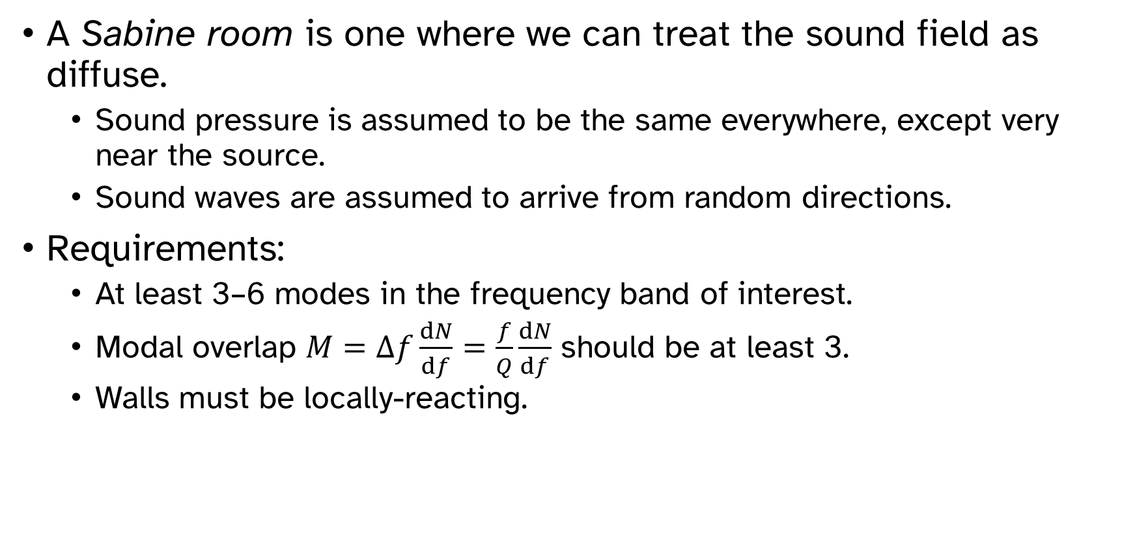
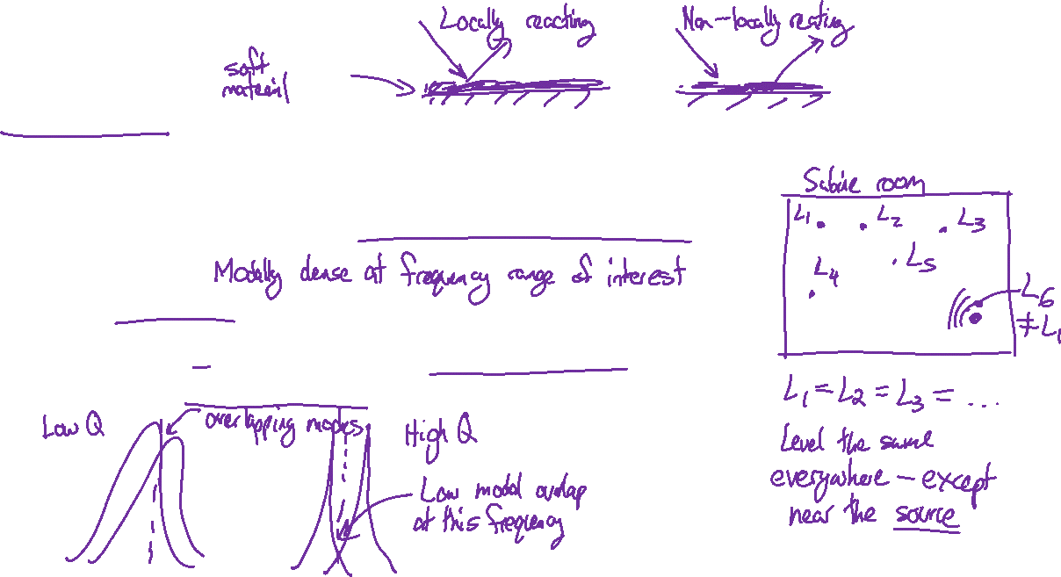
Sabine room
A Sabine room is one where we can treat the sound field as diffuse.
Sound pressure is assumed to be the same everywhere, except very near the source.
Sound waves are assumed to arrive from random directions.
Requirements:
At least 3–6 modes in the frequency band of interest.
Modal overlap $M=Δf\frac{dN}{df}=\frac{f}{Q}\frac{dN}{df}$ should be at least 3.
Walls must be locally-reacting.

Slide 6
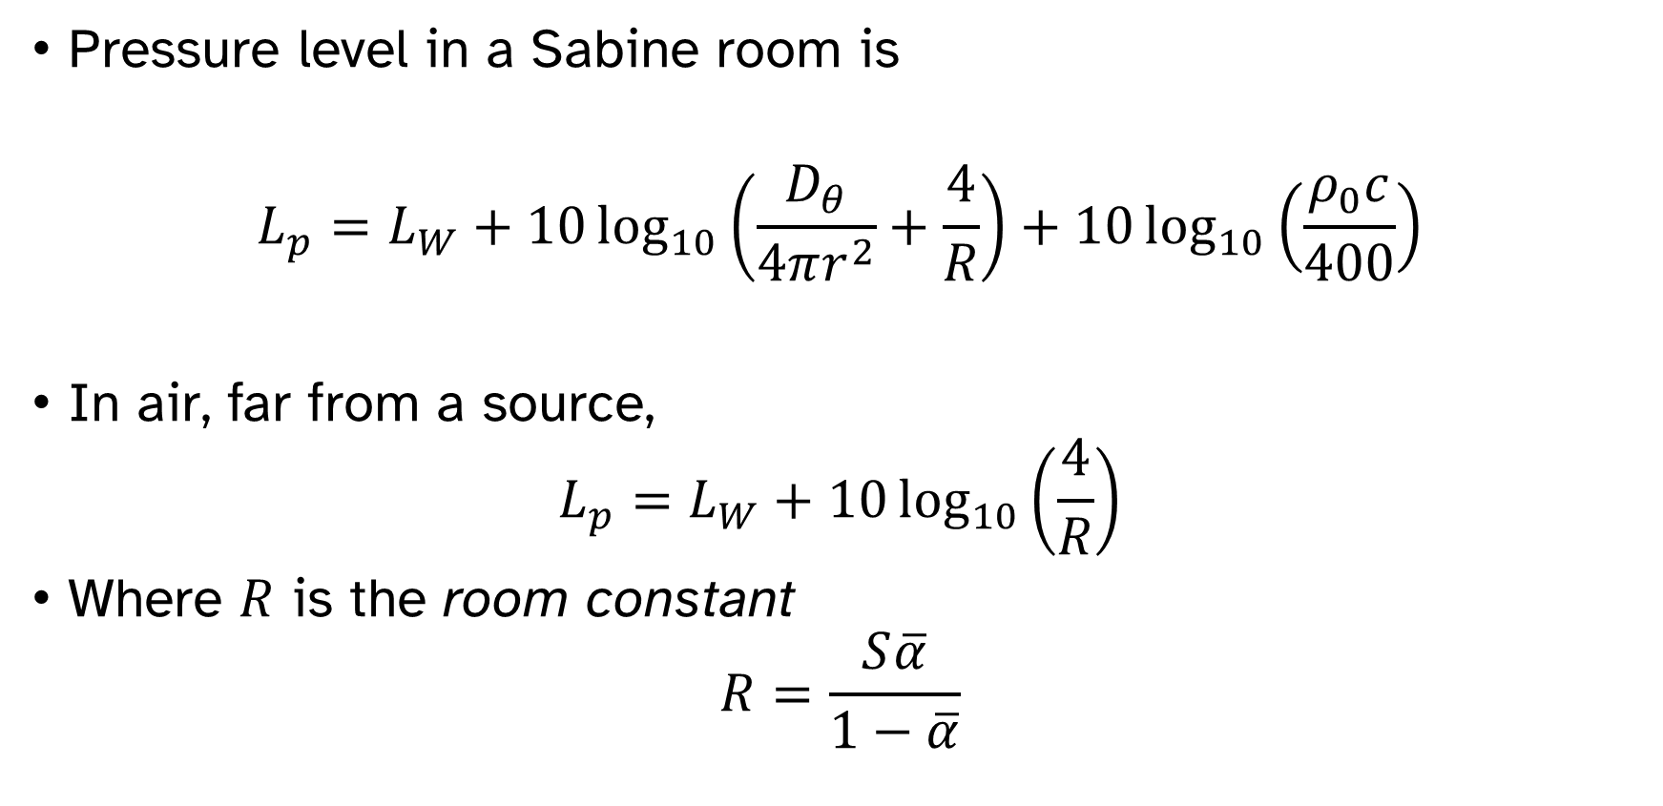
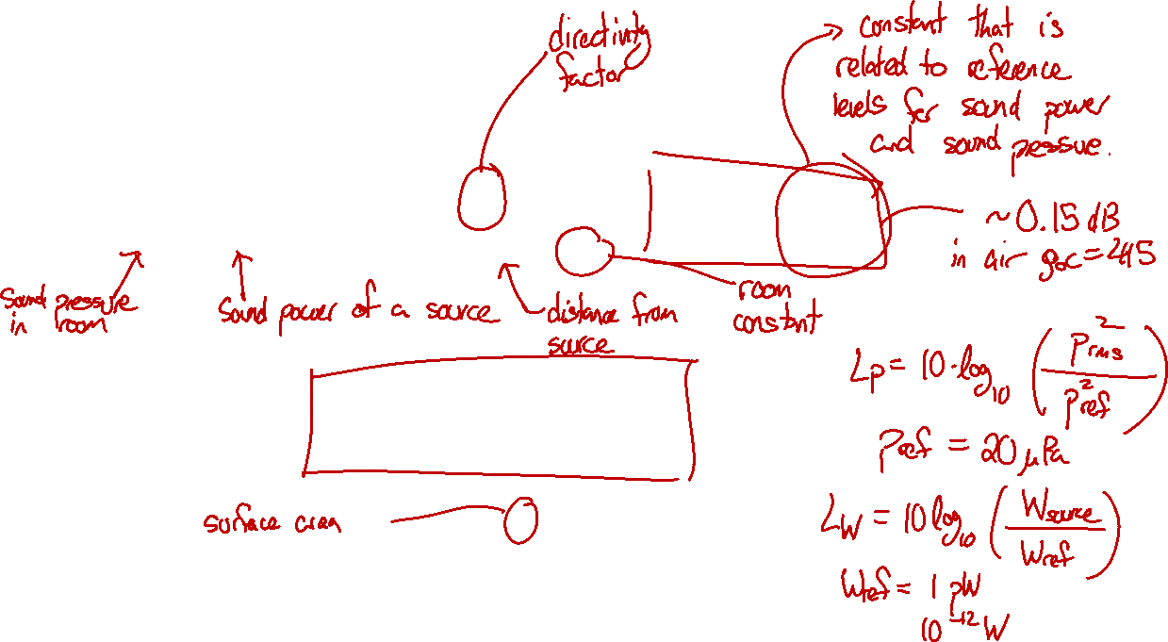
Sabine room
Pressure level in a Sabine room is
$$L_{p}=L_{W}+10\log_{10}\left(\frac{D_{θ}}{4πr^{2}}+\frac{4}{R}\right)+10\log_{10}\left(\frac{ρ_{0}c}{400}\right)$$
In air, far from a source,
$$L_{p}=L_{W}+10\log_{10}\left(\frac{4}{R}\right)$$
Where $R$ is the room constant
$$R=\frac{S\overline{α}}{1−\overline{α}}$$

Slide 7
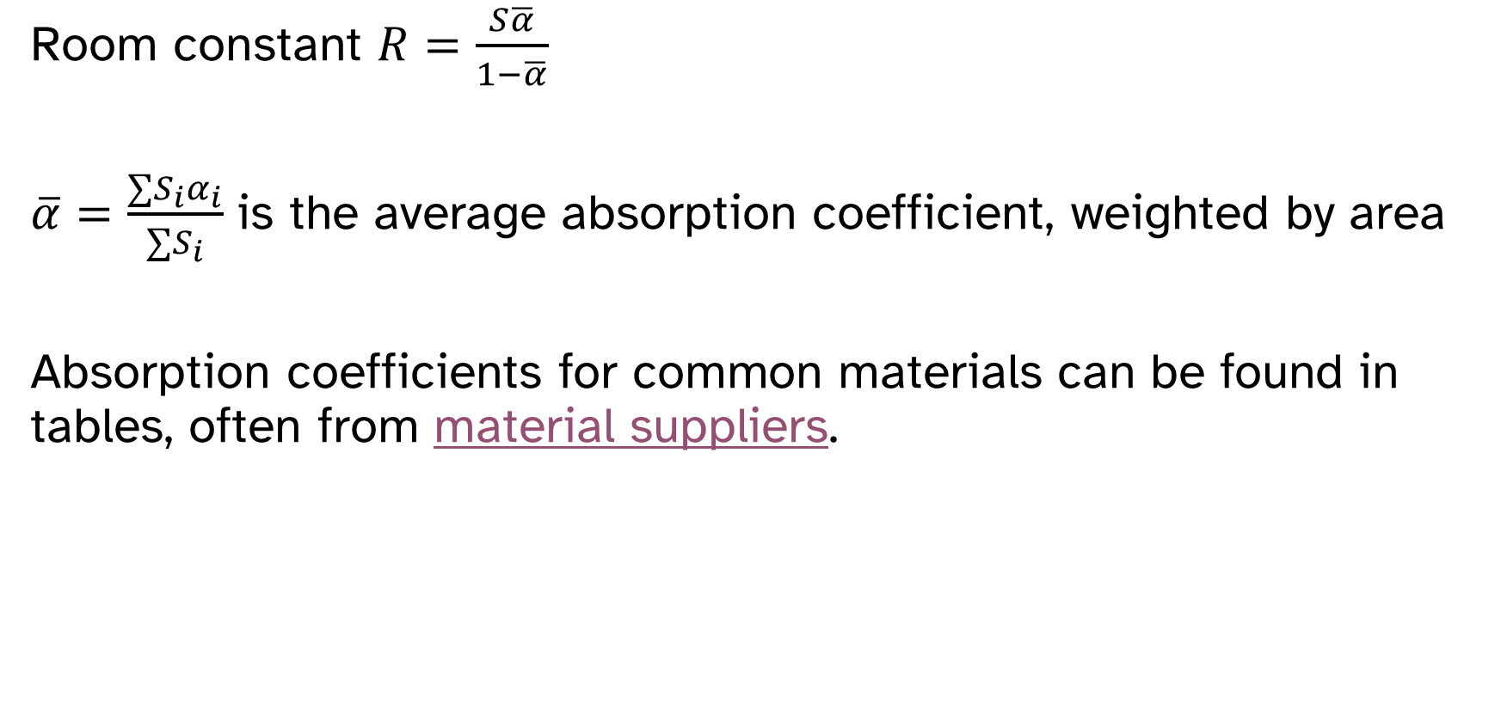
Room constant
Room constant $R=\frac{S\overline{α}}{1−\overline{α}}$
$\overline{α}=\frac{∑S_{i}α_{i}}{∑S_{i}}$ is the average absorption coefficient, weighted by area
Absorption coefficients for common materials can be found in tables, often from material suppliers.

Slide 8
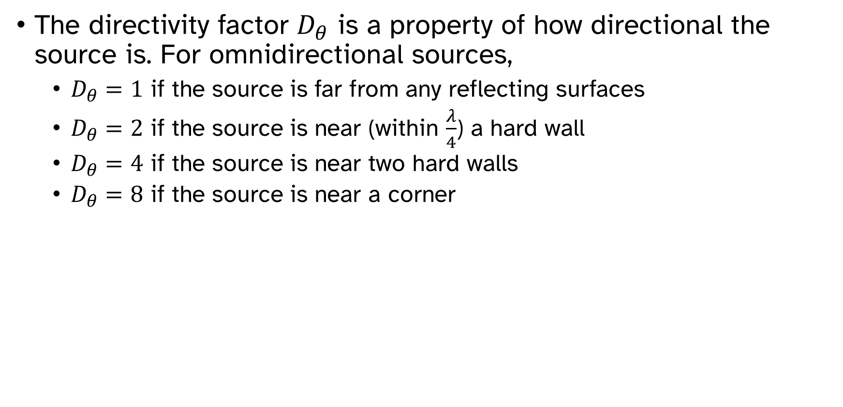
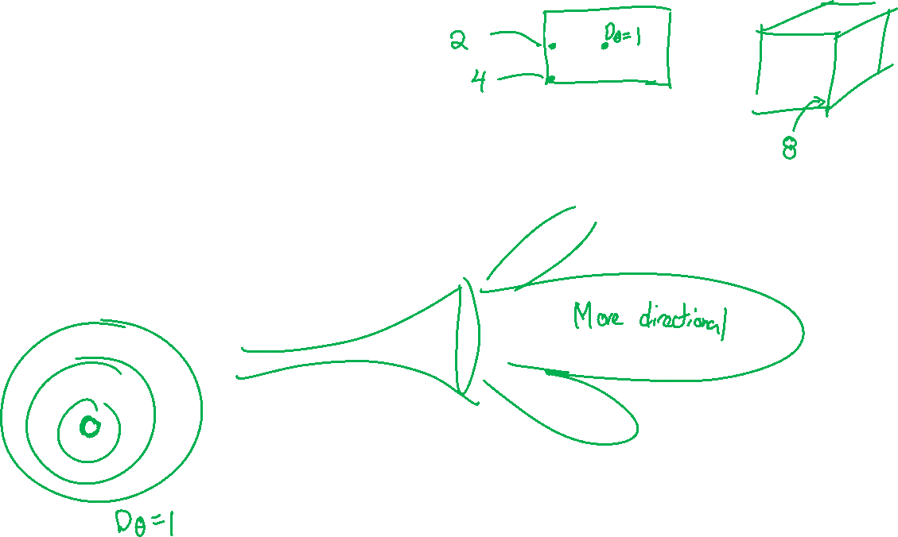
Directivity factor
The directivity factor $D_{θ}$ is a property of how directional the source is. For omnidirectional sources,
$D_{θ}=1$ if the source is far from any reflecting surfaces
$D_{θ}=2$ if the source is near (within $\frac{λ}{4}$) a hard wall
$D_{θ}=4$ if the source is near two hard walls
$D_{θ}=8$ if the source is near a corner

Slide 9

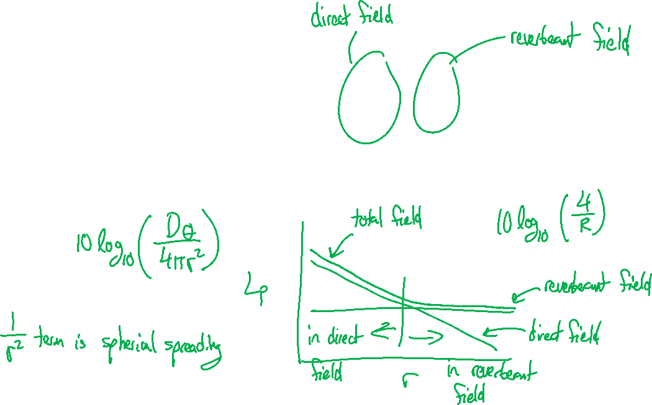
Direct and reverberant fields
$$L_{p}=L_{W}+10\log_{10}\left(\frac{D_{θ}}{4πr^{2}}+\frac{4}{R}\right)$$
If a receiver is in the direct field of a source, adding absorption will not be very beneficial.

Slide 10

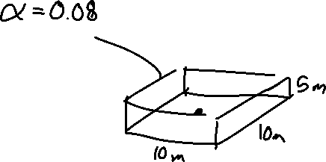
Example problem: adding treatment
Room 10 m $×$ 10 m $×$ 5 m
Machine in the center of the floor and operates at 250 Hz.
All surfaces have absorption $α=0.08$
How much quieter will the room be if the walls and ceiling are treated with absorbing material with $α=0.5$?

Slide 11
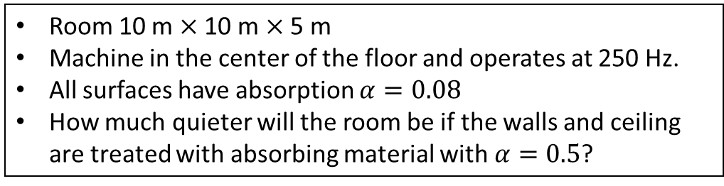

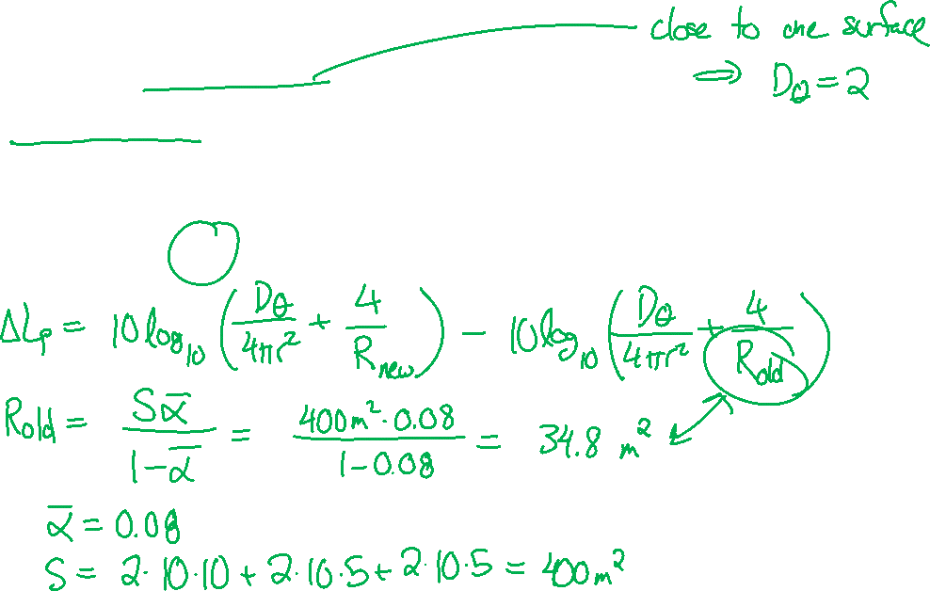
Example problem: adding treatment
Room 10 m $×$ 10 m $×$ 5 m
Machine in the center of the floor and operates at 250 Hz.
All surfaces have absorption $α=0.08$
How much quieter will the room be if the walls and ceiling are treated with absorbing material with $α=0.5$?
$$L_{p}=L_{W}+10\log_{10}\left(\frac{D_{θ}}{4πr^{2}}+\frac{4}{R}\right)+10\log_{10}\left(\frac{ρ_{0}c}{400}\right)$$

Slide 12
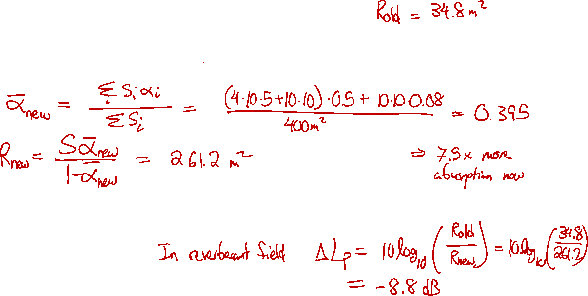
Example problem: adding treatment
Room 10 m $×$ 10 m $×$ 5 m
Machine in the center of the floor and operates at 250 Hz.
All surfaces have absorption $α=0.08$
How much quieter will the room be if the walls and ceiling are treated with absorbing material with $α=0.5$?

Slide 13
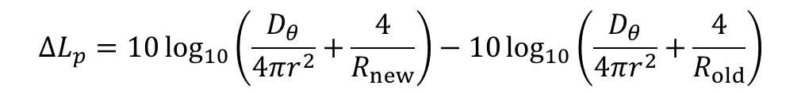
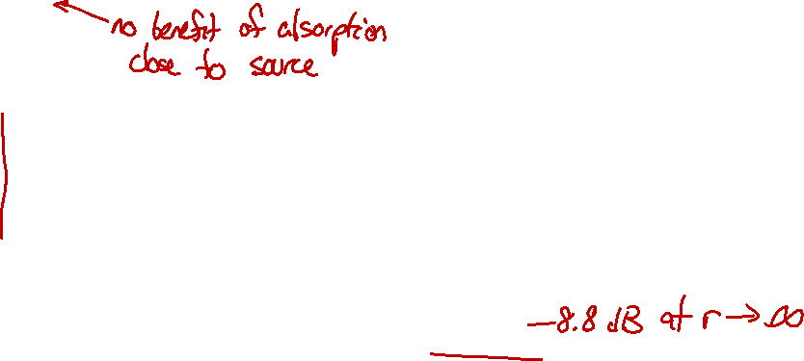
Example problem: adding treatment
Room 10 m $×$ 10 m $×$ 5 m
Machine in the center of the floor and operates at 250 Hz.
All surfaces have absorption $α=0.08$
How much quieter will the room be if the walls and ceiling are treated with absorbing material with $α=0.5$?
$$ΔL_{p}=10\log_{10}\left(\frac{D_{θ}}{4πr^{2}}+\frac{4}{R_{new}}\right)−10\log_{10}\left(\frac{D_{θ}}{4πr^{2}}+\frac{4}{R_{old}}\right)$$

Slide 14

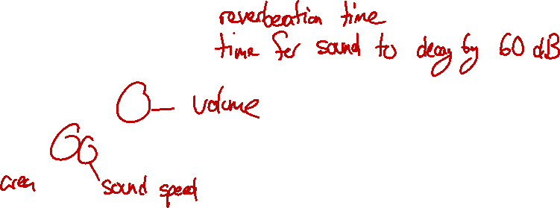
Measuring the room constant
The average absorption $\overline{α}$ can be calculated from reverberation time,
$$T_{60}=\frac{55.25V}{Sc\overline{α}}$$
$$\overline{α}=\frac{55.25V}{ScT_{60}}$$

Slide 15
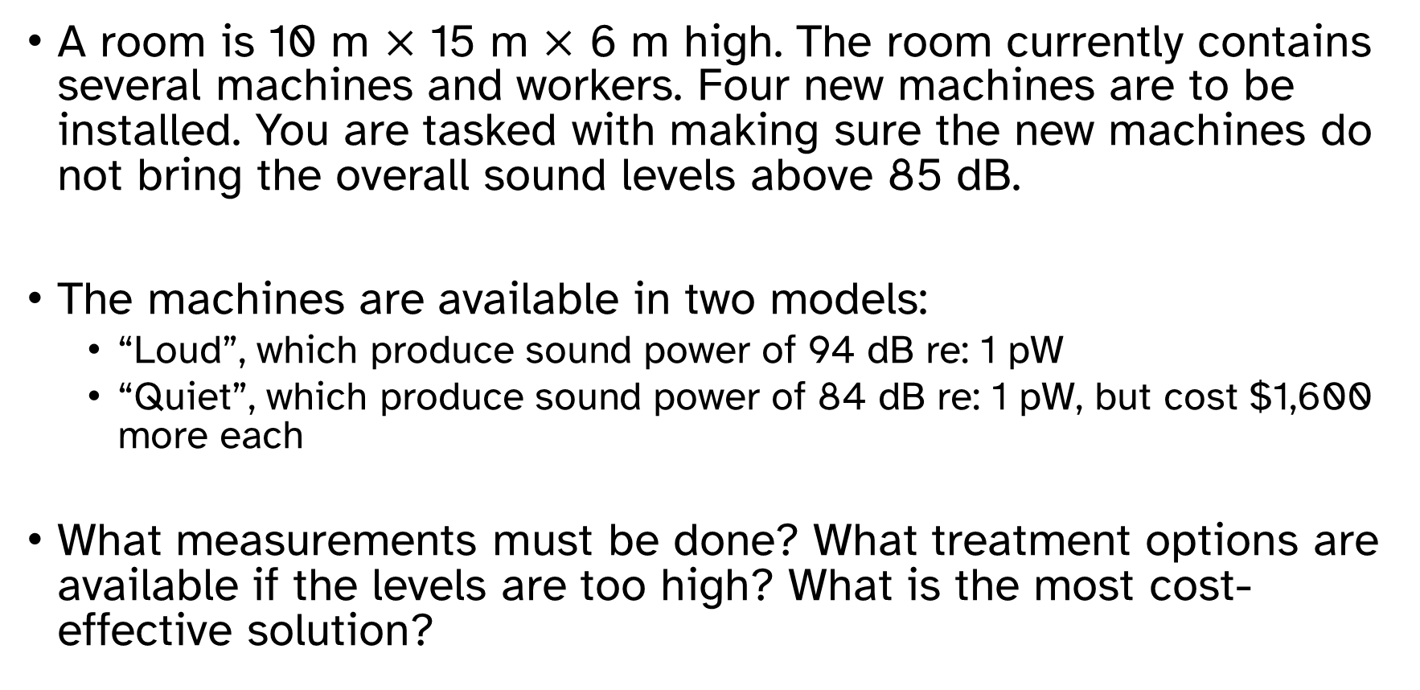

Example problem: treatment options
A room is 10 m $×$ 15 m $×$ 6 m high. The room currently contains several machines and workers. Four new machines are to be installed. You are tasked with making sure the new machines do not bring the overall sound levels above 85 dB.
The machines are available in two models:
“Loud”, which produce sound power of 94 dB re: 1 pW
“Quiet”, which produce sound power of 84 dB re: 1 pW, but cost $1,600 more each
What measurements must be done? What treatment options are available if the levels are too high? What is the most cost-effective solution?

Slide 16
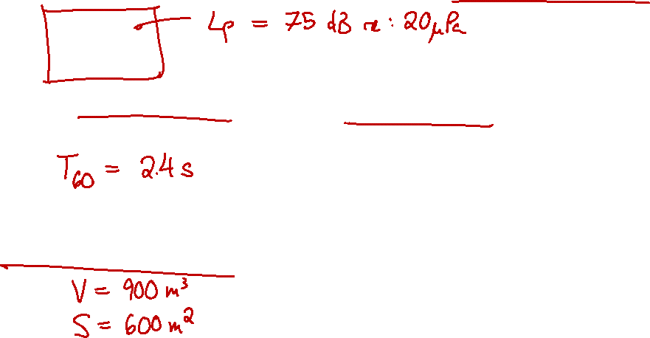
Example problem: treatment options
Step 1: baseline measurements
Measure existing sound pressure levels with the other machines on
Measure reverberation time with the machines off
Calculate volume and area

Slide 17

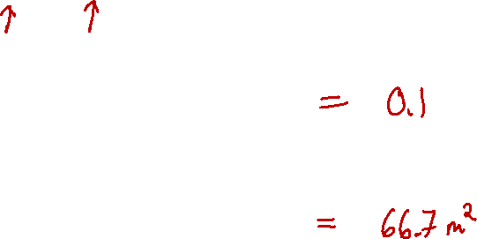
Example problem: treatment options
Step 2: calculate baseline conditions
$$L_{p}=L_{W}+10\log_{10}\left(\frac{D_{θ}}{4πr^{2}}+\frac{4}{R}\right)$$
$$\overline{α}=\frac{55.25V}{ScT_{60}}$$
$$R=\frac{S\overline{α}}{1−\overline{α}}$$

Slide 18

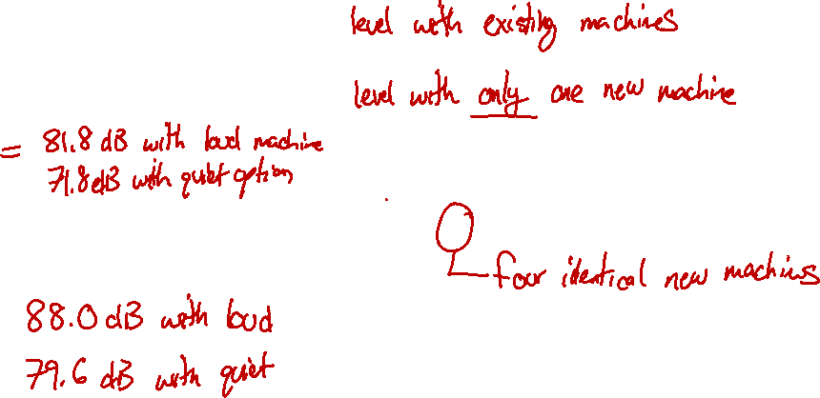
Example problem: treatment options
Step 3: initial predicted level
$L_{p, orig}=75$ dB re: 20 $μ$Pa
$L_{p, new}=L_{W}+10\log_{10}\left(\frac{4}{R}\right)$
$L_{p, combined}=10\log_{10}\left({10}^{\frac{L_{p, orig}}{10}}+4⋅{10}^{\frac{L_{p, new}}{10}}\right)$

Slide 19

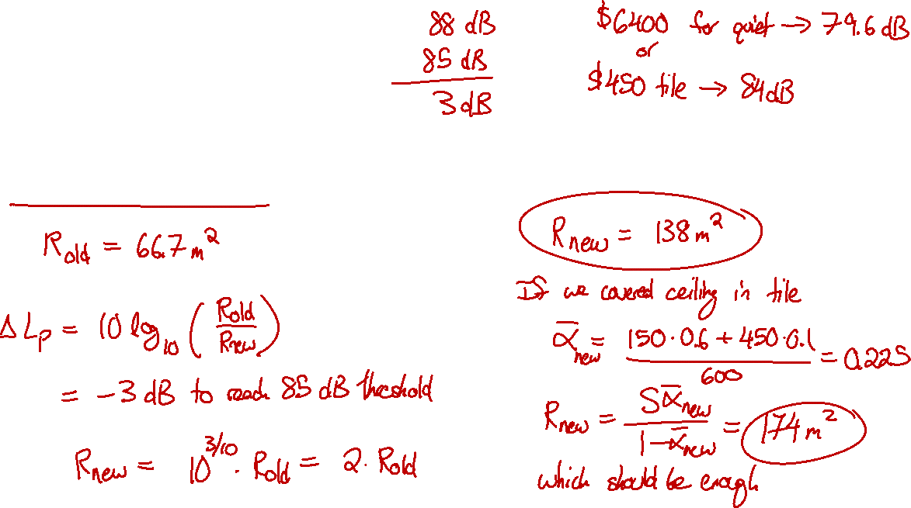
Example problem: treatment options
Explore other options
What if we bought the loud machines and then spent money on absorbing material?
Acoustic tile with $α=0.6$ is $3 per square meter.

Slide 20

Example problem: treatment options
Explore other options
Acoustic tile with $α=0.6$ is $3 per square meter.
Covering the ceiling in acoustic tile would cost $450

Slide 21
Octave bands
If a source acts at multiple octave or one-third octave bands, treat them as separate sub-problems, then add all of the energy together (combine levels) at the end.

Slide 22
